Slide 1
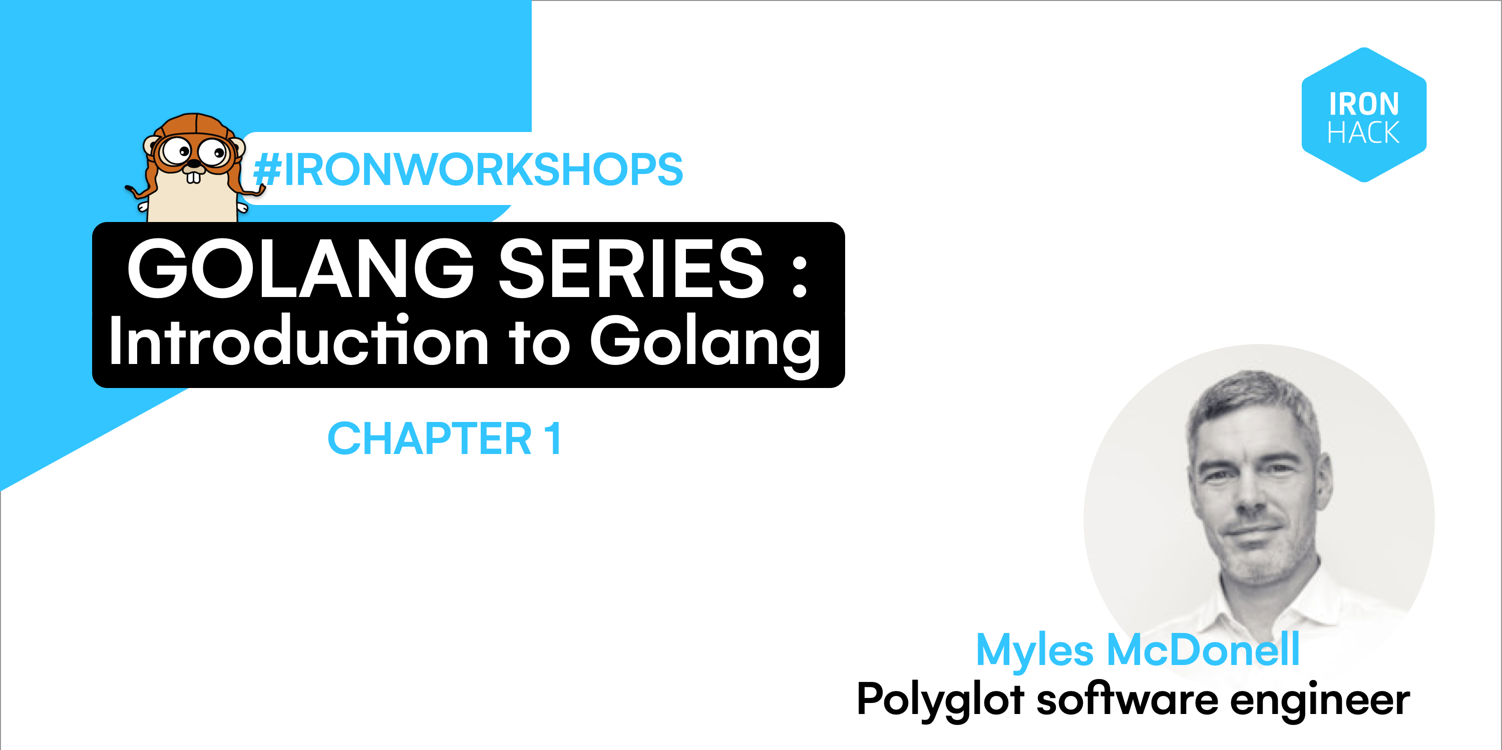

Slide 3
Origins of Golang
Googlers: Rob Pike, Robert Griesemer & Ken Thompson
First Public Release: 2010
The goals of the Go project were to eliminate the slowness and clumsiness of software development at Google, and thereby to make the process more productive and scalable. The language was designed by and for people who write and read and debug and maintain large software systems. – Rob Pike

Slide 4
Companies/Systems using Golang

Slide 5
Attributes of Golang
Strongly Typed
Imperative
First Class Functions
Compiled to Arch > No managed runtime
Implicit Interface Implementation > Duck Typing
Polymorphism via Composition > No inheritance
Idiomatic (not really an attribute but..)

Slide 6
Golang Proverbs
Don’t communicate by sharing memory, share memory by communicating
Concurrency is not parallelism
Channels orchestrate; mutexes serialise
The bigger the interface the weaker the abstraction

Slide 7
Golang Proverbs
Gofmt’s style is no one’s favourite, yet gofmt is everyone’s favourite
A little copying is better than a little dependency
Clear is better than clever
Reflection is never clear

Slide 8
Golang Proverbs
Don’t just check errors handle them gracefully
Documentation is for users
Don’t panic

Slide 9
Golang and concurrency
Goroutines; lightweight processes than can run concurrently with other goroutine. Conceptually like a thread but without the cost.
Channels; a medium for sending a recieving messages between goroutines.
Communicating Sequential Processes (Tony Hoare 1978); a formal language for describing patterns of interaction in concurrent systems

Slide 10
End of Moore’s law

Slide 11
Golang Resources
https://golang.org/
https://dave.cheney.net/
https://www.youtube.com/watch?v=cN_DpYBzKso (Rob Pike on Concurrency)
https://go-proverbs.github.io/

